Slide 1
STYLES
by Mykola Sotula

Slide 2
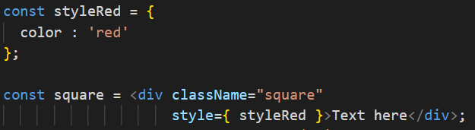
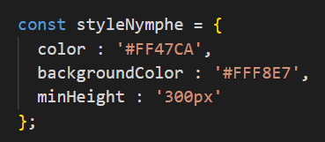
INLINE STYLES
Form styles as object and add as component attribute value
Write style property names in a CamelCase style.

Slide 3

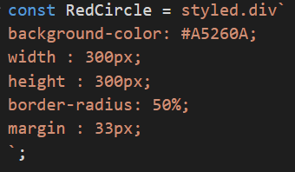
STYLED COMPONENTS
Install styled components
Import styled components
Create component with css styles
Paste component to JSX

Slide 4
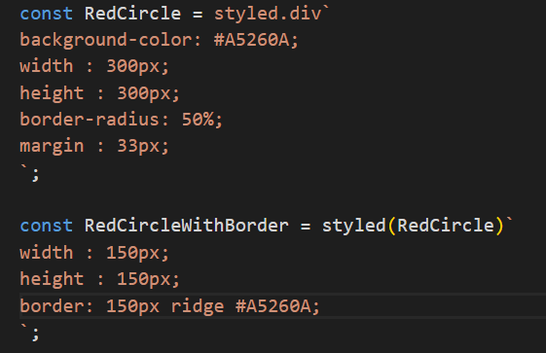
STYLED COMPONENTS
You can extend your own styles

Slide 5
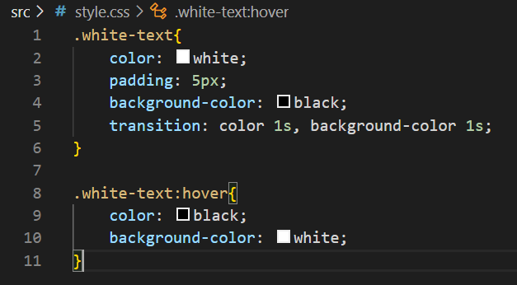

.CSS FILES
type css in file
Import to component file
Use

Slide 6
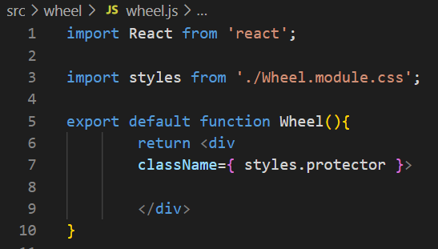
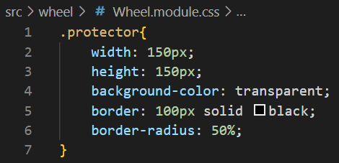
CSS MODULES
Like .css files, but has features.
CSS Modules allows the scoping of CSS by automatically creating a unique classname of the format [filename]\_[classname]\_\_[hash].
For using the [name].module.css file naming convention.

Slide 7


